Slide 1
LET'S UPGRADE
PYTHON SESSION
ASSIGNMENT 1
BY AHALYAA.K

Slide 2
QUESTIONS:
List - 2 List with some brand names and arrange them in ascending order .
Overlapping in both list.
Range with even numbers starting from 20 to 40 with steps of 2 .

Slide 3
1. I. List with some brand names and arrange them in ascending order
watches=["rolex","titan","fastrack","omega","roadster","gio","citizen"]
watches.sort()
print("brand watches in ascending order:", watches)
RESULT:
brand watches in ascending order: ['citizen', 'fastrack', 'gio', 'omega', 'roadster', 'rolex', 'titan']

Slide 4
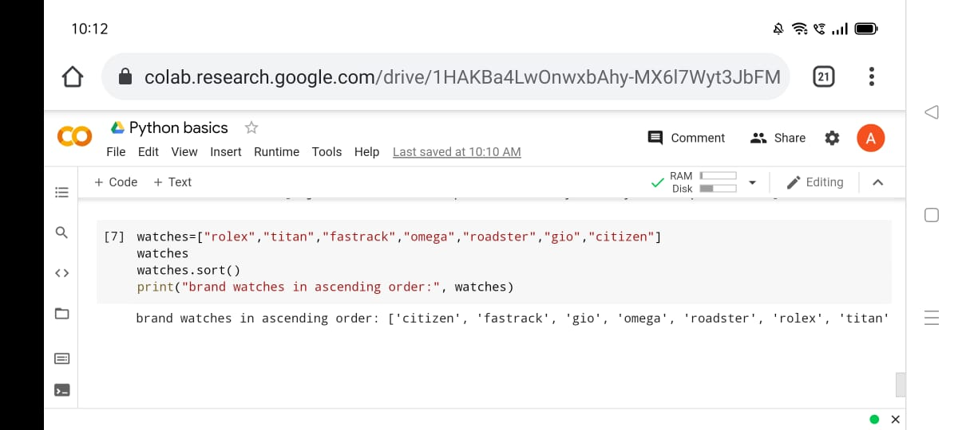

Slide 5
II. List with some brand names and arrange them in ascending order
chocolate=["cadbury","nestle","amul","ferrero","hersheys","mars","godiva"]
chocolate.sort()
print("chocolate brand names in ascending order:",chocolate)
RESULT:
chocolate brand names in ascending order: ['amul', 'cadbury', 'ferrero', 'godiva', 'hersheys', 'mars', 'nestle']

Slide 6
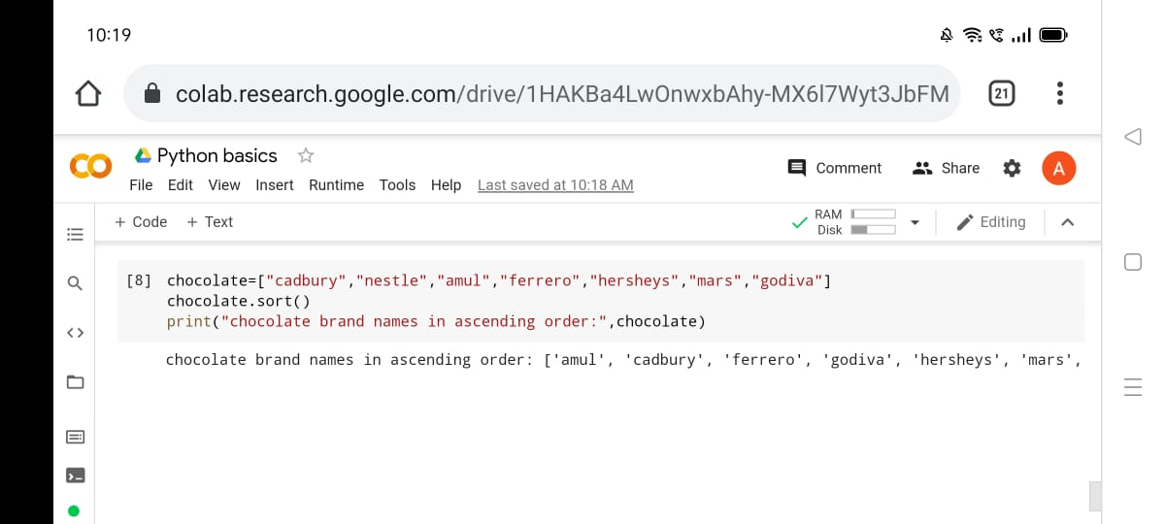

Slide 7
2. Overlapping in both list.
import random
n1=random.sample(range(1,20),6)
n2=random.sample(range(1,25),2)
l=[each for each in n1 if each in n2]
print("\n First line is:",n1)
print("\n second line is:",n2)
print("\n common element in the list is",l)
RESULT:
First line is: [8, 10, 17, 12, 16, 3]
second line is: [2, 10]
common element in the list is [10]

Slide 8
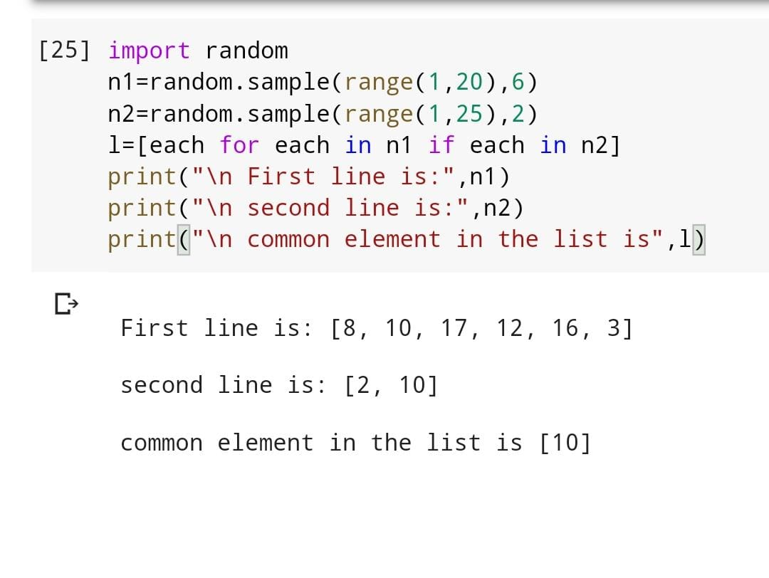

Slide 9
3.Range with even numbers starting from 20 to 40 with steps of 2 .
x=range(20,40,2)
for a in x:
print(a)
RESULT:
20
22
24
26
28
30
32
34
36
38

Slide 10
